Slide 1
ATAI
Advanced Techniqueof Artificial Intelligence
ATAI
ChongqingUniversity _{AdvancedTechniqueof}
of Technology Artificial Intelligence
Chongqing University of
Technology
Chongqing University ^{ATAI}
_{of Technology} Advanced Techniqueof
Artificial Intelligence
Chongqing University of Technology
Chongqing University of Technology
Token-Level Contrastive Learning with Modality-Aware Prompting for Multimodal Intent Recognition
Code:https://github.com/thuiar/TCL-MAP.
2024.3.14 •ChongQing
—— AAAI 2024
Reported by YaoChen Li
1

Slide 2
ATAI
AdvancedTechniqueof
Artificial Intelligence
ATAI
ChongqingUniversity _{AdvancedTechniqueof}
of Technology Artificial Intelligence
ChongqingUniversity of Technology
Motivation
1.Intent recognition is primarily a text-centric task, it is crucial to explore the association between nonverbal modalities and text modality.
2.Mining semantic information from video and audio modality poses a significant difficulty due to the complex nature of the intent concept.

Slide 3
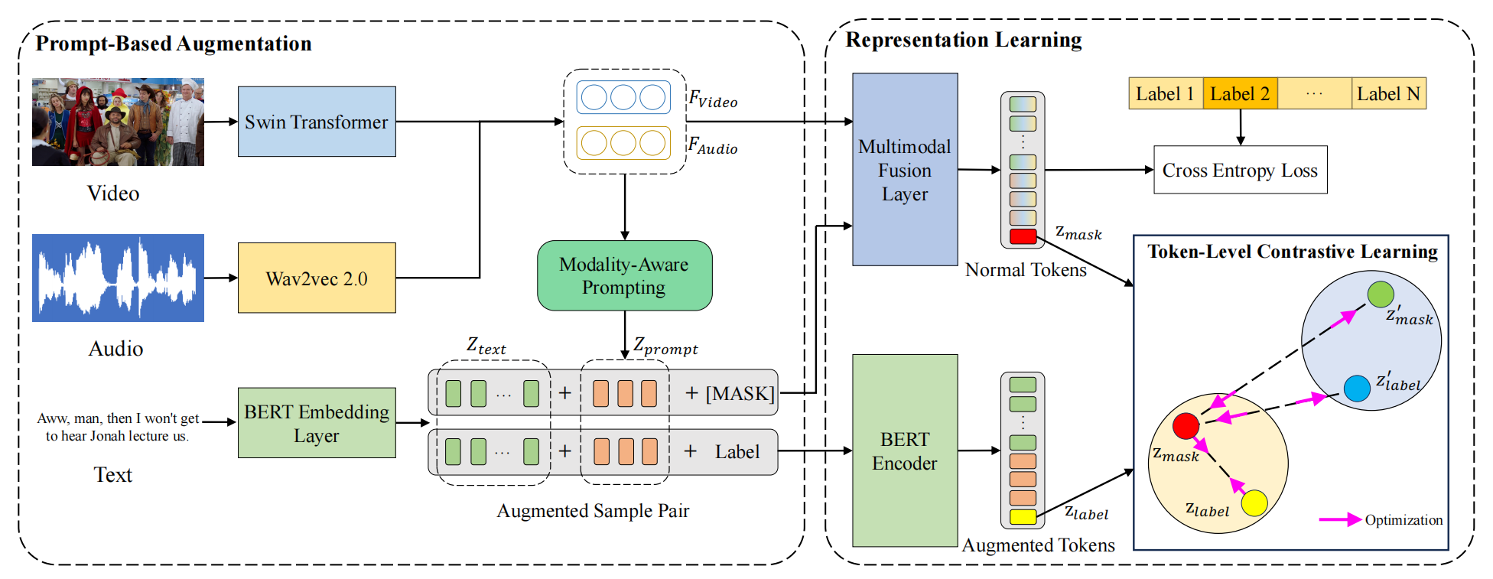
ChongqingUniversity of Technology
ATAI
AdvancedTechniqueof
Artificial Intelligence
ATAI
ChongqingUniversity _{AdvancedTechniqueof}
of Technology Artificial Intelligence
Overview

Slide 4
ChongqingUniversity of Technology
ATAI
AdvancedTechniqueof
Artificial Intelligence
ATAI
ChongqingUniversity _{AdvancedTechniqueof}
of Technology Artificial Intelligence
Overview

Slide 5
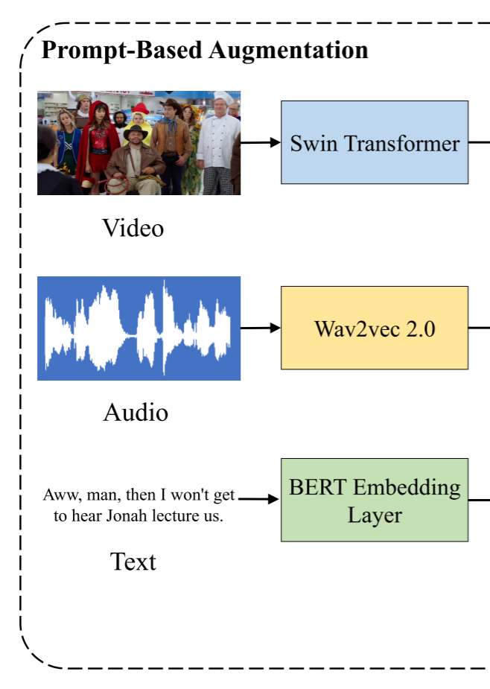
ChongqingUniversity of Technology
ATAI
AdvancedTechniqueof
Artificial Intelligence
ATAI
ChongqingUniversity _{AdvancedTechniqueof}
of Technology Artificial Intelligence
Method

Slide 6
ChongqingUniversity of Technology
ATAI
AdvancedTechniqueof
Artificial Intelligence
ATAI
ChongqingUniversity _{AdvancedTechniqueof}
of Technology Artificial Intelligence
Method

Slide 7
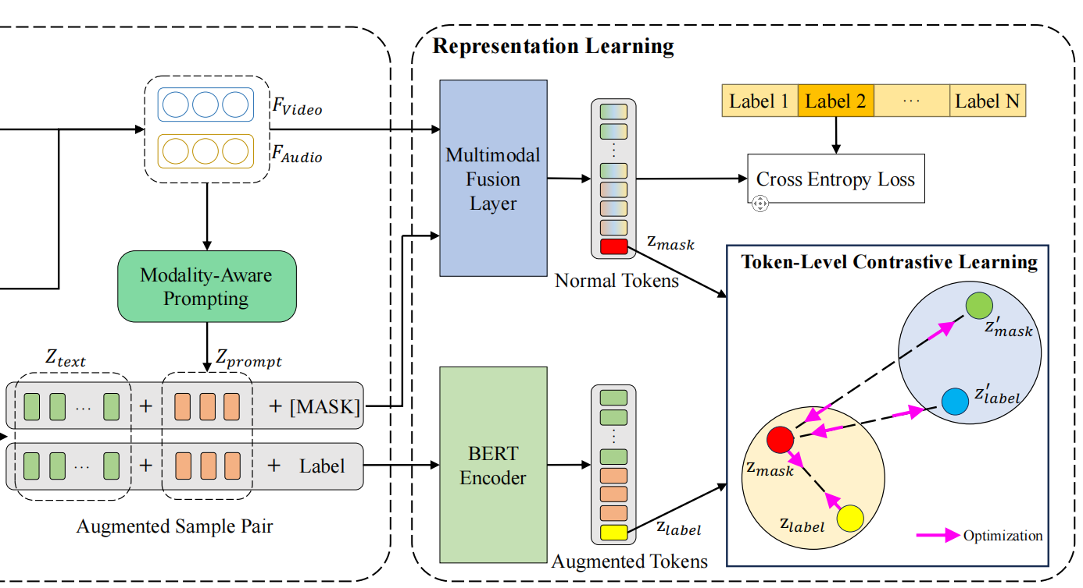
ChongqingUniversity of Technology
ATAI
AdvancedTechniqueof
Artificial Intelligence
ATAI
ChongqingUniversity _{AdvancedTechniqueof}
of Technology Artificial Intelligence
Method

Slide 8
ATAI
AdvancedTechniqueof
Artificial Intelligence
ATAI
ChongqingUniversity _{AdvancedTechniqueof}
of Technology Artificial Intelligence
ChongqingUniversity of Technology
Experiments

Slide 9
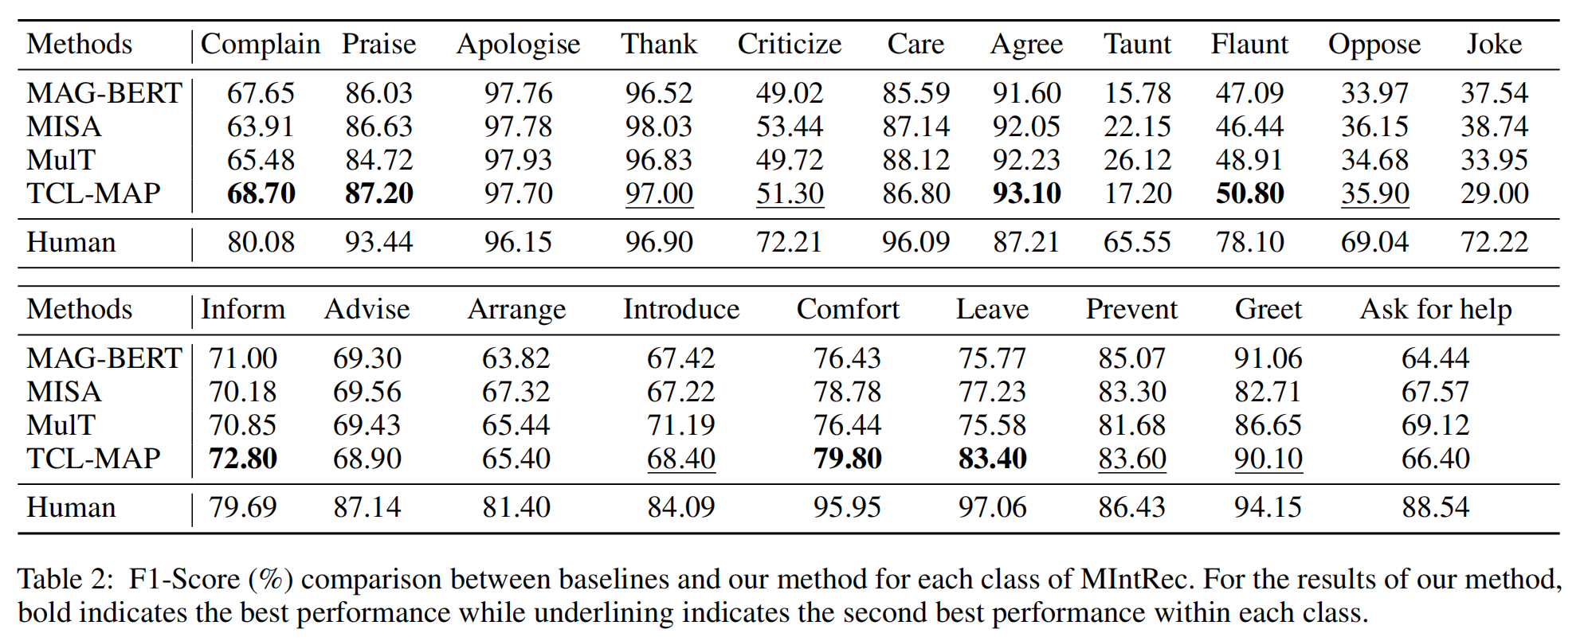
ATAI
AdvancedTechniqueof
Artificial Intelligence
ATAI
ChongqingUniversity _{AdvancedTechniqueof}
of Technology Artificial Intelligence
ChongqingUniversity of Technology
Experiments

Slide 10
ChongqingUniversity of Technology
ATAI
AdvancedTechniqueof
Artificial Intelligence
ATAI
ChongqingUniversity _{AdvancedTechniqueof}
of Technology Artificial Intelligence
Experiments

Slide 11
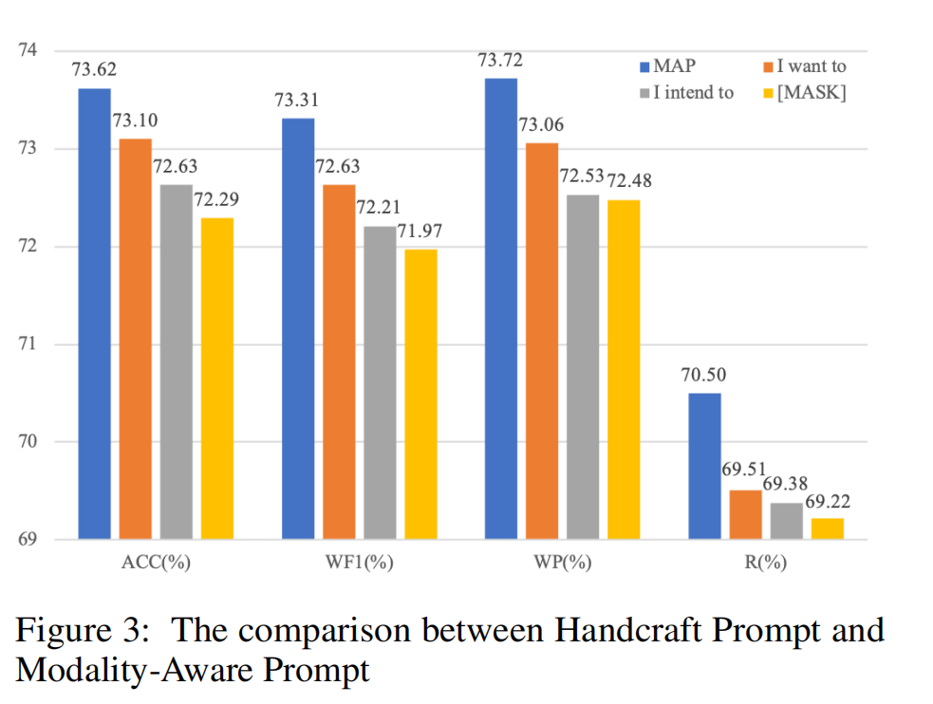
ChongqingUniversity of Technology
ATAI
AdvancedTechniqueof
Artificial Intelligence
ATAI
ChongqingUniversity _{AdvancedTechniqueof}
of Technology Artificial Intelligence
Experiments

Slide 12
ChongqingUniversity of Technology
ATAI
AdvancedTechniqueof
Artificial Intelligence
ATAI
ChongqingUniversity _{AdvancedTechniqueof}
of Technology Artificial Intelligence
Thanks!

